Slide 1
C++ for Advanced Mathematical Finance week 8 pt1
Simon Hartley

Slide 2
Introduction – SYLLABUS
OBJECT-ORIENTED PROGRAMMING
Basics of object-oriented programming in C++
STL Classes
Classes
Objects
Inheritance or Polymorphism

Slide 3
C++ – Code Paradigms
C++ is a multi-paradigm, systems-level language that provides high-level abstractions with very low runtime cost.
A paradigm is a way of thinking about the organisation and construction of software.
A programming paradigm does not refer to a specific language but a methodology.
Some languages make it easy to write in some paradigms but not others.

Slide 4
C++ – Code Paradigms
Procedural Programming
based upon the original concept the procedure call. Procedures, also known as routines, subroutines, or functions, simply contain a series of computational steps to be carried out.

Slide 5
C++ – Code Paradigms
float sum(float x=0, float y=1, float z=2) {
std::cout << "Add " << x << " to "
<< y << " to "
<< z << std::endl;
return x + y + z;
}
int main() {
auto a = sum(); // a = sum(0, 1, 2);
auto b = sum(10); // b = sum(10, 1, 2);
auto c = sum(31,40); // c = sum(31, 40, 2);
auto d = sum(19,13,17); // d = sum(19, 13, 17);
std::cout << a << " " << b << " "
<< c << " " << d << std::endl;
return 0;
}

Slide 6
C++ – Code Paradigms
Functional Programming
emphasizes the evaluation of expressions, rather than execution of commands.
The expressions are formed by using functions to combine basic values.
FAQ for comp.lang.functional

Slide 7
C++ – Lambdas
Lambdas are anonymous (without name) in-place functions.
[] () {
std::cout << “a C++ Lambda!";
} ();

Slide 8
C++ – Lambdas
Lambdas are anonymous (without name) in-place functions.
[] () {
std::cout << “a C++ Lambda!";
} ();
You see four pairs of brackets. Let’s see what each means:
[] is lambda introducer or lambda closure
() is for argument list
{} contains the body of lambda
() is used to call the lambda

Slide 9
C++ – Lambdas
Functional Example
auto sum = [] (double A, double B) { return A + B; };
auto add = sum;
std::cout << add(3.25, 5.65) <<std::endl;

Slide 10
C++ – Code Paradigms
Object Orientated
uses "objects" –
data structures consisting of data fields and methods together with their interactions
class A {}; struct B{}; union C{};

Slide 11
OOP – We already used OOP
#include <string>
int main() {
// string variable.
// It can only hold strings. Note ""
std::string c = "Hello World";
return 0;
}

Slide 12
OOP – Principles
Data abstraction
Encapsulation
Messaging
Modularity
Polymorphism
Inheritance

Slide 13
OOP – Why is C not OOP?
struct Point {
double x;
double y;
};
void distance(Point p1, Point p2);

Slide 14
OOP – Classes in C++
When you define a class, you define a blueprint for a data type.
This doesn't actually define any data, but it does define what the class name means, that is, what an object of the class will consist of and what operations can be performed on such an object.

Slide 15
OOP – Object via Classes
Class declarations
For ordinary functions, we learned it is good practice to declare them in header (.h) files, and write the code in Source (.cpp, Cxx) files. We will do the same for classes!

Slide 16
OOP – Classes in C++
Simple Class Example:
class Person {
public :
std::string strName;
double height_m;
double weight_kg;
int iAge;
double CalculateBMI(void) {
return weight_kg / (height_m * height_m);
}
};
int main(void) {
Person aPerson ; // an instance of the class
aPerson.strName = " Person";
aPerson.iAge = 18;
}

Slide 17
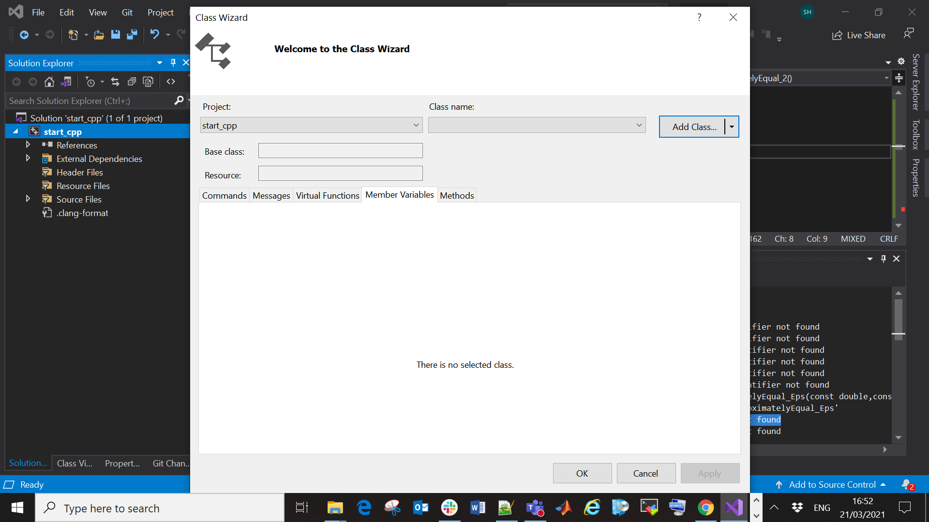
OOP – Classes and File organisation

Slide 18
OOP – is a vs has a relationships
Isa refers to the type we have created e.g.
class Person
Hasa refers to a property of the type and in the implementation.
std::string strName;

Slide 19
OOP – Data Abstraction
Data abstraction refers to providing only essential information about the data to the outside world, hiding the background details or implementation.

Slide 20
OOP – Data Abstraction and encapsulation
class Person {
public:
double CalculateBMI (void);
private:
std::string strName;
double height_m;
double weight_kg;
int iAge;
};

Slide 21
OOP – Data Abstraction and encapsulation
How do we set or access private data?
We need to write public functions that do this
class Person {
public:
double CalculateBMI (void);
void SetName(std::string aName);
std::string GetName (void);
...
private:
// Most member variables will be here
std::string strName;
...
};

Slide 22
OOP – Encapsulation
It may seem cumbersome to write two functions to read or write on private member data
However, for complex programs, this provides control over what data may be accessed and modified
Functions that change member variables may also provide checks
There may be checks of mathematical consistency.
E.g. that numbers such as strike or volatility of options are positive numbers
There may be additional checks or warnings for financially reasonable values.
E.g. if a trader enters a single trade valued billions of pounds, a warning may ask if the trader really intended a trade of that size
These can be implemented in get and set functions

Slide 23
OOP – Inheritance
We implemented the class Person that contains some basic features of a Person (weight, height etc)
If we want to write code representing Students, each Student is obviously a Person, so also has a weight, height etc.
But a student has more features than an average person, such as: their course, their modules etc
Inheritance allows us to efficiently recycle and extend code where we have dependencies similar to those between Person and Student

Slide 24
OOP – Inheritance
Person
std::string strName;
Is a
I
Student
Teacher

Slide 25
OOP – Inheritance
class Student: public Person {
...
};
class Teacher: public Person {
...
};
Inherited code is easier to maintain and extend: If a bug in Person is fixed, the same bug will be fixed for Student and Teacher. If we extend Person, we automatically extend
Student and Teacher.

Slide 26
OOP – Inheritance
Write a class Student that derives from person
Convince yourself that in main, an object of type Student can access public member data and functions from the class Person. Write accessor functions for the new data in the Student class (strUniversity, etc)
class Student: public Person {
public:
void SportsAssignment(void );
private:
std::string strUniversity;
std::string strSubject;
std::vector <std::string> Modules;
};

Slide 27
OOP – Inheritance
Implement the function SportsAssignment as follows:
If the height of the student is greater than 1.8 m, the student is assigned to the basketball course. Otherwise, the student is assigned to the football course. Can you access height_m from the base class Person in your function?

Slide 28
OOP – Inheritance
Private member data from the base class will not be
accessible in the derived class
Using public accessor functions within the derived class to access private member data from the base class works, but is not always desirable
For some data, we may not wish to have public accessor at all
We may not want anyone outside the base or derived classes to modify some of our data
For this purpose, there is a third way to control access to data (besides private and public): protected
protected data appears private to code outside the class, but is accessible to derived classes

Slide 29
OOP – Encapsulation
Encapsulation is the technical term for wrapping data and functions into one object. The keywords public, protected and private are critical for access control.
Modifier | Who has access
public | Everyone has access
protected | Only objects from the base and from derived classes
private | Only objects from the base class

Slide 30
OOP – Inheritance
We had a class Student that derives from person
We could have used protected or private here. That would change the access level the base class data and methods have within the derived class.
class Student: public Person {
…
};
class Student: modifier Person {
…
};

Slide 31
OOP – Inheritance
class A {
public:
int x;
protected:
int y;
private:
int z;
};
class B: public A{
// x is public
// y is protected // z is not accessible from B
};
class C: protected A{
// x is protected
// y is protected // z is not accessible from C
};
class D: private A{
// x is private
// y is private // z is not accessible from D
};

